Slide 1
Title
Wednesday talk – date
Name

Slide 2
Timeline: PhD / post doc
Start
Month year
End
Month year
year 1
year 2
year 3
X %
current date
Paper #1
Paper #2
Conf. #1
Paper #3
Conf. #2

Slide 3
(Ti,Al)(O,N)
PC
? ? ? ? ? ?
RQ’#?:
Question itself

Slide 4
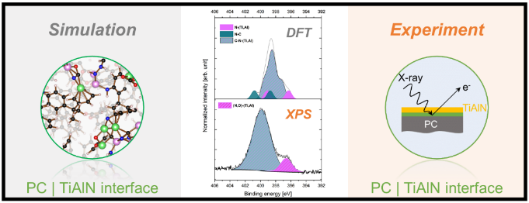
Context: Overview of projects on the interfacial bond formation with PC
Paper
Manuscript
Analysis of data
Bond formation at polycarbonate | X interfaces (X = Ti, Al, TiAl) probed by X-ray photoelectron spectroscopy and density functional theory molecular dynamics simulations
Correlative theoretical and experimental study of the PC | X interfacial bond formation (X = TiN, AlN, TiAlN) during DC magnetron sputtering
Theoretical and experimental bond formation at polycarbonate | X interfaces (X = TiO₂, Al₂O_{3,} (Ti,Al)O)
Lena Patterer*, Pavel Ondracka, Dimitri Bogdanovski, Leonie Jende, Stephan Prünte, Stanislav Mráz, Soheil Karimi Aghda, Bastian Stelzer, Markus Momma,
Jochen M. Schneider
Lena Patterer*, Pavel Ondračka, Dimitri Bogdanovski, Stanislav Mráz, Soheil Karimi Aghda, Peter Pöllmann, Yu-Ping Chien, Jochen M. Schneider
Lena Patterer¹*, Pavel Ondračka², Dimitri Bogdanovski¹, Stanislav Mráz¹, Soheil Karimi Aghda¹, Jochen M. Schneider¹
< 1% pores
Metal
Metal nitride
Metal oxide
Ti, Al, TiAl
TiN, AlN, TiAlN
TiO₂, Al₂O₃, (Ti,Al)O

Slide 5
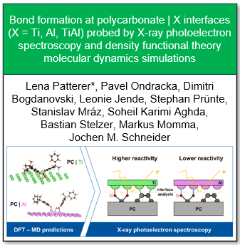
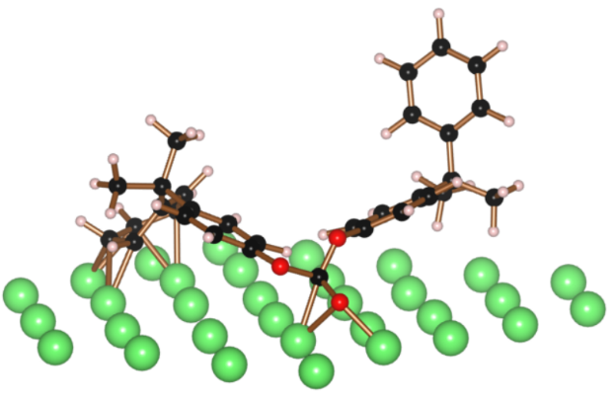
Binding energies for interacting PC dimer are calculated
Theoretically determined broadened BEs
Selected configuration of MD simulation
Momma, K.; Izumi, F. J. Appl. Crystallogr. 2011, 44 (6), 1272–1276

Slide 6
… more results

Slide 7
Lesson(s) learnt…
Summary of obtained knowledge
Answers to question: “What have I learnt?:

Slide 8
(Ti,Al)(N,O)
PC
? ? ?
Thank you
for your attention!

Slide 9
Backup

